Slide 1


School of Computer Science & IT Department of BCA
INTRODUCTION TO LINUX(20BCA1C06)
MODULE 2: The UNIX File System
Faculty : Dr. Ananta Ojha

Slide 2
Session-7
System Calls for the File System
Change Directory and Change Root
Change Owner and Change Mode
Stat and Fstat
Pipes
Mount and Unmount
Link and Unlink

Slide 3
Change Directory and Change Root
The system call chdir changes the current directory of a process.
Syntax: chdir (pathname);
where pathname is the directory that becomes the new current directory of the process.
The kernel searches the file system for the pathname and converts it to inode using algorithm namei
If the file is not a directory and process owner has no access permission to the directory, it returns error.
Otherwise, unlock the in-core inode of the new directory and release the in-core inode of the old directory using algorithm iput.
A process usually uses the global file system root for all path names starting with "/". Processes can change their current root via chroot system call.
Syntax: chroot (pathname);
where pathname is the directory that the kernel subsequently treats as the process's root directory.
When executing the chroot system call, the kernel follows the same algorithm as for chdir system call. However, since the default root for the kernel is stored in a global variable, it does not release the inode of the old root.
The new inode is now the logical root of the file system , meaning that all pathname searches that start from root ("/") will start from this inode.

Slide 4
Change Owner and Change Mode
Changing the owner or mode (access permissions) of a file are operations on the inode.
Syntax: chown (pathname, owner, group)
The kernel converts the pathname to an inode using algorithm namei.
Checks the process owner must be superuser or match that of the file owner (a process cannot give away something that does not belong to it).
The kernel then modifies the in-core inode of the file with the new owner and group, and releases the in-core inode using algorithm iput, the kernel writes the inode to disk. (After the change of ownership, the old owner loses "owner" access rights to the file.)
Syntax: chmod (pathname, mode)
To change the mode of a file, the kernel follows a similar procedure, changing the mode flags in the in-core inode instead of the owner and group.

Slide 5
Stat and Fstat
The system calls stat and fstat allow processes to query the status of files, returning information such as the file type, file owner, access permissions, file size, number of links, inode number, and file access times.
Syntax: stat (pathname, statbuffer);
where pathname is a file name, and statbuffer is the address of a data structure in the user process that will contain the status information of the file on completion of the call.
The kernel converts the pathname to inode and write the fields of the inode into statbuffer .
Syntax: fstat (fd, statbuffer);
where fd is a file descriptor returned by a previous open system call.
The system calls simply get the inode of the opened file using the fd, and write the fields of the inode into statbuffer .

Slide 6
Pipes
Pipes allow transfer of data between processes. There are two kinds of pipes: named pipes and unnamed pipes.
Named pipes are created with mknod system call and unnamed pipes are created with the pipe system call. Unnamed pipes are more common.
Named pipes permanently exist in the file system hierarchy (subject to their removal by the unlink system call), but unnamed pipes are transient: When all processes finish using the pipe, the kernel reclaims its inode.
Access to unnamed pipes is shared only by child processes. However, named pipes can be shared between any processes.
The Pipe System Call
Syntax: pipe (fdptr);
where fdptr is the pointer to an integer array that will contain the two file descriptors for reading and writing the pipe.
The kernel creates a pipe file and allocates an inode. It assigns a pair of file descriptors and corresponding file table entries for the pipe.
Pipes use the same data structures as used by normal files, the user file descriptor table, file table, and the in-core inode table; as a result, the system calls to read/write files remains same and the processes do not need to know whether they are reading a normal file or a pipe.

Slide 7
Mounting and Unmounting File Systems
A physical disk may have many logical partitions, and each partition can have a file system on it. The mount system call connects the file system in a specified section of a disk to the existing file system hierarchy, and the umount system call disconnects a file system from the hierarchy.
The kernel only allows the superuser to mount or unmount file systems.
Syntax: mount (special pathname, directory pathname, options);
where special pathname is the name of the device file of the disk partition whose file system is to be mounted. The directory pathname is the path in existing file system where the new file system will be mounted. The options indicate whether to mount in a "read-only" manner.
Once mounted, the processes can seamlessly access this newly mounted file system.
Syntax: unmount (special filename);
where special filename indicates the file system to be unmounted.

Slide 8
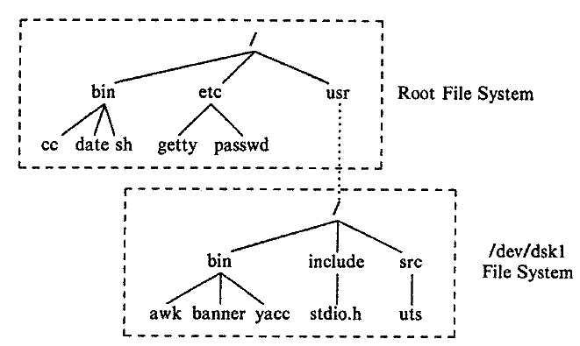
File System Tree Before and After Mount

Slide 9
Link and Unlink System Calls
The link system call links a file to a new name in the directory structure. It creates a new directory entry which points to an existing inode.
Syntax: link (source file name, target file name);
After linking the files, the kernel does not keep track of which file name was the original one. Therefore, no name is treated specially.
The unlink system call removes a directory entry for a file.
Syntax: unlink (pathname);
If a process unlinks a given file, no file is accessible by that name until another directory entry with that name is created.

Slide 10

THANK YOU Any questions…?

